Slide 1
PHP – Lecture 2
Variables, Datatypes & Operators

Slide 2
Variables and Operators
Variables in PHP are identical to variables in most other programming languages.
For the uninitiated, a variable is a name given to an imaginary box into which any value may be placed.
Variable names are case sensitive.
The following statement creates a variable called $testvariable (all variable names in PHP begin with a dollar sign) and assigns it a value of 3:
$testvariable = 3;
PHP is a loosely typed language.
This means that a single variable may contain any type of data (be it a number, a string of text, or some other kind of value), and may change types over its lifetime.
Consider the following statements:
$testvariable = 3;
$testvariable = ’Three’;
The variable changes type: where it used to contain a number, it now contains a string of text:

Slide 3
There are a few rules that you need to follow when choosing a name for your PHP variables.
PHP variables must start with a letter or underscore "_".
PHP variables may only be comprised of alpha-numeric characters and underscores. a-z, A-Z, 0-9, or _ .
Variables with more than one word should be separated with underscores. $my_variable
Variables with more than one word can also be distinguished with capitalization. $myVariable

Slide 4
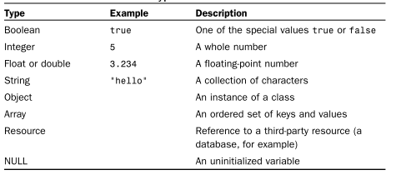
Data Types
8 standard data types in PHP.
array - holds an array of items, e.g. several strings or several integers.
object - a reference to an instance of a class. This is related to Object Oriented programming, which we will talk more about later on.
NULL - a value of null is nothing. It's not the same as 0 (zero), because that's actually a value. Null is truly nothing. Variables which have not yet been assigned a value, or which you have used the unset() method on, will carry the NULL value. This is useful if you wish to check whether or not a variable contains any value - you may compare it against the NULL constant.

Slide 5
How to display what's in your variables
To display things on the page, we've used echo .
If you're printing direct text, then you need the quotation marks (either single or double quotes).
echo “Hi”;
To print what's inside of a variable, just type the variable name (including the dollar).
Finally, the line of code ends as normal - with a semi-colon (;). We'll now set up a variable and print it to the page.
<?php
$test_String = ‘It Worked!’;
echo $test_String;
?>

Slide 6
WORKING WITH TEXT
In programming, another term for text is string.
Variables that contain text are called string variables.
“Hello, world!” is a string.
To assign that string to a variable, use the equal sign ( = ). This is actually called the assignment operator.
The = takes what is on the right side and uses that to set the value on the left side.
This piece of code assigns a value to $myVar and then displays it.
<?php
$myVar = ‘Hi, my name is Andy’;
echo $myVar;
?>

Slide 7
You can use either the single quote or the double quote when assigning a string value.
Up to now, single and double quotes can be used interchangeably. There is a difference in how the two act.
If you use double quotes, the PHP parser converts variables into their value within the string.
The following code will interpret $myVar as Hi, my name is Andy and echo that value to screen.
<?php
$myName = ‘Andy’;
$myVar = “Hi, my name is $myName”;
echo $myVar;
?>

Slide 8
Or you could do the following which also outputs Hi, my name is Andy
If, however, you use single quotes, $myVar is interpreted as Hi, my name is $myName
The PHP parser does not expand the variable; that is, it does not replace the variable with the value inside the variable, so in both cases below Hi, my name is $myName is output.
<?php
$myName = ‘Andy’;
echo “Hi, my name is $myName”;
?>
<?php
$myName = ‘Andy’;
$myVar = ‘Hi, my name is $myName’;
echo $myVar;
?>
or
<?php
$myName = ‘Andy’;
echo ‘Hi, my name is $myName’;
?>

Slide 9
Sometimes with double quotes there is some ambiguity about what exactly the parser should interpret as a variable to be translated.
This can happen if text starts immediately after the variable.
You can put curly braces ( {} ) around the variable to delineate it. The following code interprets $myVar as
There are 5 cats
<?php
$myAnimal = ‘cat’;
$myVar = “There are 5 {$myAnimal}s”;
echo $myVar;
?>

Slide 10
It can happen that you have both single quotes and double quotes in the data that you need to quote.
At that point you need to escape the quote. To escape something is to tell the PHP parser that the character is a data character and is not to be used as a control character, such as the ending quote.
To escape, type a backslash ( \ ) before the character that needs to be escaped:
<?php
$saying1 = ‘She said, “I didn\’t hear what you said.”’;
$saying2 = “She said, \”I didn’t hear what you said.\””;
echo $saying1;
echo ‘<br>’;
echo $saying2;
?>

Slide 11
Working with the Concatenation Operator
You can attach two string values together. They can either be actual strings or variables that have strings in them. This is called concatenation. You use a period ( . ) to concatenate the different strings:
Notice that there is a space after the word is . All the spaces are ignored after the single quote until you get to the variable. So if you do not have the space after is and before the single quote, $myVar would be Hi, my name isAndy.
The spaces are optional around the concatenation operator and are there to make the code easier to read.
<?php
$myName = ‘Andy’;
$myVar = ‘Hi, my name is ‘ . $myName;
echo $myVar;
?>

Slide 12
If you are concatenating two variables and need a space between them, you concatenate a string that consists of just a space:
The last . is not a concatenation period, but the period at the end of the sentence. So $myVar is equal to Hi, my name is Andy Tarr.
<?php
$firstName = ‘Andy’;
$lastName = ‘Tarr’;
$myVar = ‘Hi, my name is ‘ . $firstName. ‘ ‘ . $lastName . ‘.’;
echo $myVar;
?>

Slide 13
In PHP you often have different ways of doing the same thing. You could accomplish the same thing using double quotes and no concatenation:
<?php
$firstName = ‘Andy’;
$lastName = ‘Tarr’;
$myVar = “Hi, my name is $firstName $lastName.”;
echo $myVar;
?>
<?php
$firstName = ‘Andy’;
$lastName = ‘Tarr’;
echo “Hi, my name is $firstName $lastName.”;
?>

Slide 14
WORKING WITH NUMBERS
PHP works with two different types of numbers: integer and ﬂoating-point numbers.
Integers are whole numbers. They have no decimal points and can be positive, negative, or zero.
Floating-point numbers are numbers that have decimals.
Notice that, unlike strings, there are no quotes around the number.
<?php
$result = 2;
echo $result;
?>
//The following code sets $result to 1.45:
<?php
$result = 1.45;
echo $result;
?>

Slide 15
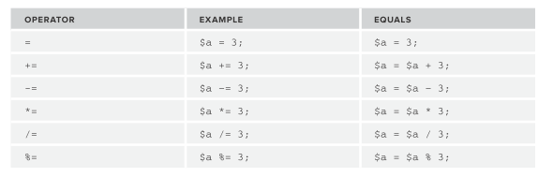
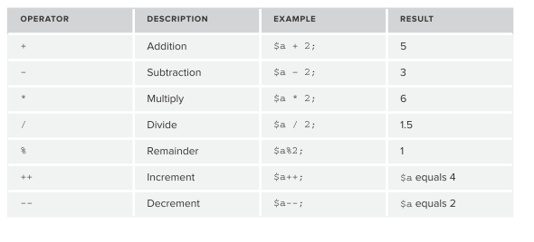
Operators
Assignment Operators
The numeric operators should look very familiar to you. $a is equal to 3 in the following table:

Slide 16
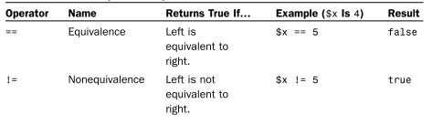
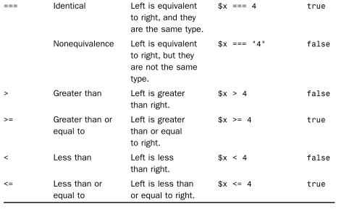
Assignment Operators
These operators are most commonly used with integers or doubles, although the equivalence operator is also used to compare strings. Be very sure to understand the difference between the == and = operators. The == operator tests equivalence, where- as the = operator assigns value. Also, remember that === tests equivalence with regard to both value and type.

Slide 17
Consider these variable examples:
Variables may be used almost anywhere that you use an actual value.
$var1 = "PHP"; // Assigns a value of "PHP" to $var1
$var2 = 5; // Assigns a value of 5 to $var2
$var3 = $var2 + 1; // Assigns a value of 6 to $var3
$var2 = $var1; // Assigns a value of "PHP" to $var2
echo $var1; // Outputs "PHP"
echo $var2; // Outputs "PHP"
echo $var3; // Outputs 6
echo $var1 . " rules!"; // Outputs "PHP rules!"
echo "$var1 rules!"; // Outputs "PHP rules!"
echo '$var1 rules!'; // Outputs '$var1 rules!'

Slide 18
Arithmetic on mixed datatypes
See the text file called addingnumersandstrings.php for a detailed explanation.
Now try this 1, what is the output ?
<?php $applesBought = 5; $applesSold = 3; echo "Now I have " . $applesBought - $applesSold . " apples left"; ?>
Can you fix this so the output is correct

Slide 19
Variable Scope
In addition to the rules for naming variables, there are rules regarding the availability of variables.
Scope can be defined as the range of availability a variable has to the program in which it is declared. PHP variables can be one of four scope types −
Local variables
A variable declared in a function is considered local; that is, it can be referenced solely in that function.
Function parameters
Function parameters are declared after the function name and inside parentheses.
Global variables
In contrast to local variables, a global variable can be accessed in any part of the program. However, in order to be modified, a global variable must be explicitly declared to be global in the function in which it is to be modified.
Static variables
a static variable will not lose its value when the function exits and will still hold that value should the function be called again.

Slide 20
Superglobal Variables
In addition to global variables of your own creation, PHP has several predefined variables called superglobals.
These variables are always present, and their values are available to all your scripts. More on these later.

Slide 21
Comments
The lines in the previous slide end with a comment.
Comments are a way to describe what your code is doing – they insert explanatory text into your code, and tell the PHP interpreter to ignore it.
Comments begin with // and they finish at the end of the same line.
You might be familiar with /* */ style comments in other languages - these work in PHP as well.

Slide 22
Add two numbers together
Remember to:
select php as save as type
save the file in the xampp\htdocs\your folder
open it through explorer using the localhost method
<body>
<?php
$number1=5;
$number2=10;
$sum=$number1 + $number2;
?>
<h1> Thinking hard……
<?php
echo “The sum of $number1 and $number2 is $sum”;
?>
</h1>
</body>
You could have the
<h1> tags inside an
echo if you wanted
but this way is more
efficient than sending
all of the text
through echo

Slide 23
Try this
Based on the previous example and given the formula for the volume of a cylinder, V, as
V = πr2h
where r is the radius and set to 5 and h the height and set to 6 of the cylinder and taking π as 3.142 , write a program to calculate and display its volume based on the formula given above .
The output is shown on the next slide.

Slide 24
